Slide 1
CUDA at Scale for the Enterprise
Multiple CPUs vs Multiple GPUs

Slide 2
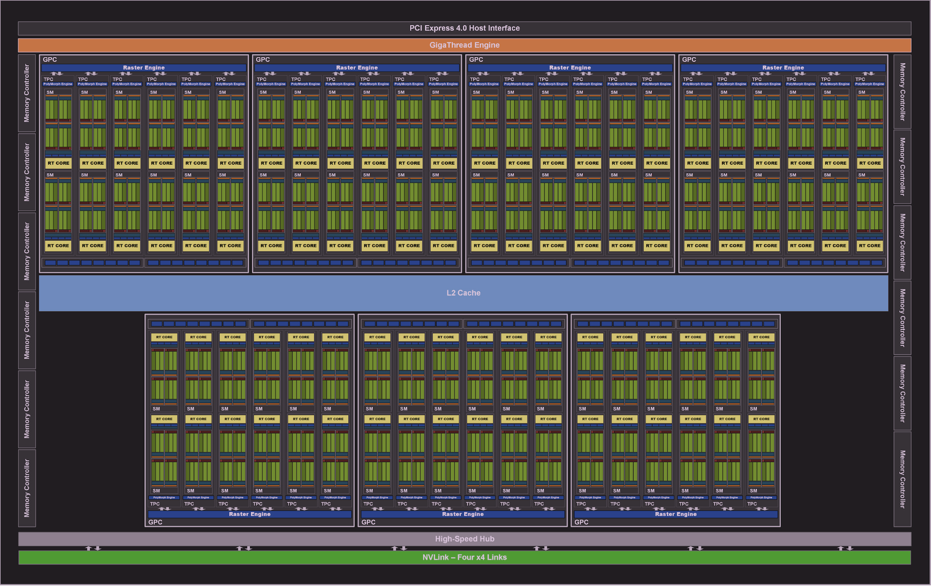
GPU Hardware and Communications
Comms channel between CPU and GPU
[1]
Comms channel between GPUs

Slide 3
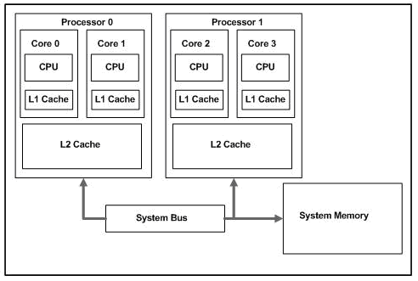
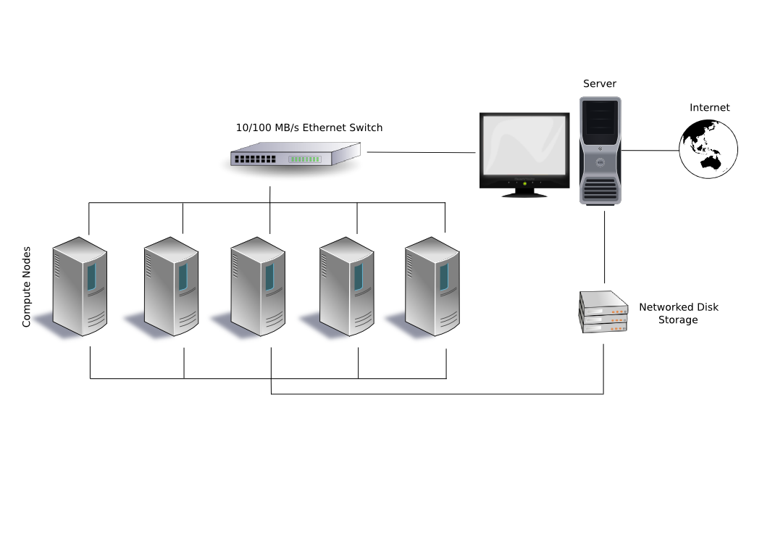
Multiple CPU Systems
[3]
[2]

Slide 4
Multiple CPU
Pros
Almost limitless memory/storage
Processors that can perform different complex calculations
Most data may not ever need to move
Cons
Costly per calculation
Need to manage networking
Highly variable configurations

Slide 5
Multiple GPU
Pros
Low cost per computation
Uniform and relatively simple computation model
When collocated on same bus can act as one
Cons
Limited communications
Requires additional hardware
Doesn’t handle complex calculations well (if not built into hardware)

Slide 6
When to use what?
Multiple CPUs
Ubiquity/Low Power/Universality
Networked processing
Very Complex Logic
Multiple GPUs
Localized (the closer the better)
Millions, Billions, and more simple computations
Computation doesn’t change frequently

Slide 7
References
[1] 2020. Nvidia. Nvidia Ampere GA102 GPU Architecture. Retrieved from https://images.nvidia.com/aem-dam/en-zz/Solutions/geforce/ampere/pdf/NVIDIA-ampere-GA102-GPU-Architecture-Whitepaper-V1.pdf.
[2] Tian, Tian and Shih, Chiu-Pi. 2012. Software Techniques for Shared-Cache Multi-Core Systems. Retrieved from https://software.intel.com/content/www/us/en/develop/articles/software-techniques-for-shared-cache-multi-core-systems.html?wapkw=smart+cache
[3] Mukarramahmad. 2008. Wikimedia Commons. Beowulf.png. Retrieved from https://commons.wikimedia.org/wiki/File:Beowulf.png
[References should be alphabetized and in APA style. Additional reference examples]

Slide 9

















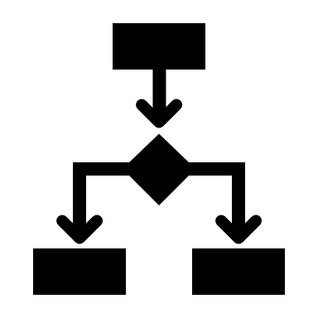



























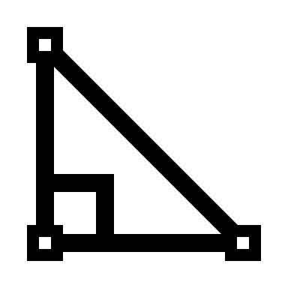




EDUCATION ICONS
ENGINEERING ICONS

